Slide 1
Banking Application
Aman Asthana
Chandhana Basavaraju
Dhanalakshmi konduru
Preritha Gangadhar

Slide 2
Case Study
The case study involves in building a Banking application.
The details like name ,age, dob ,gender and password should be provided when user get registered to the banking application.
Once user gets registered , He/She can login into the banking application using the password which has been provided while registering .
All the details will be stored in database.

Slide 3





System Requirements

Slide 4
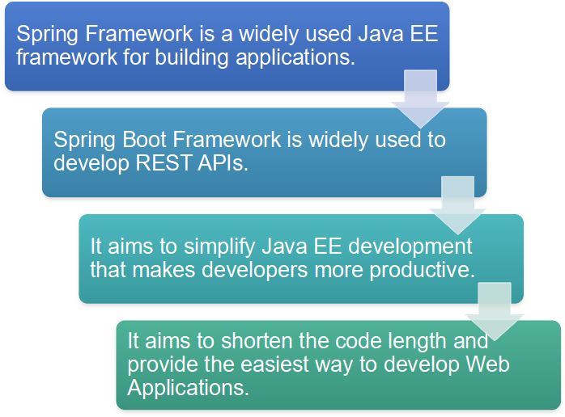
Spring Boot

Slide 5
Dependencies
<dependency> <groupId>org.springframework.boot</groupId> <artifactId>spring-boot-starter-web</artifactId> </dependency>
Spring Web
<dependency> <groupId>org.springframework.boot</groupId> <artifactId>spring-boot-starter-thymeleaf</artifactId> </dependency>
Spring Thymeleaf
<dependency> <groupId>org.springframework.boot</groupId> <artifactId>spring-boot-devtools</artifactId> <scope>runtime</scope> <optional>true</optional> </dependency>
Spring Devtools

Slide 6
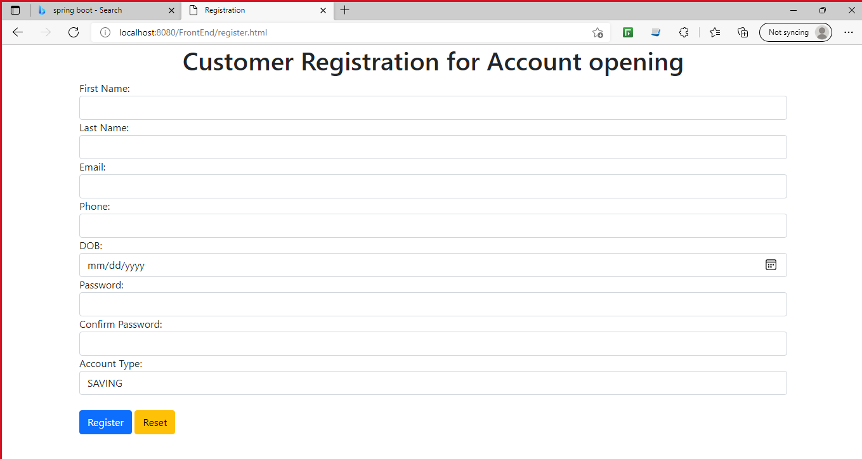
Registration Page

Slide 7
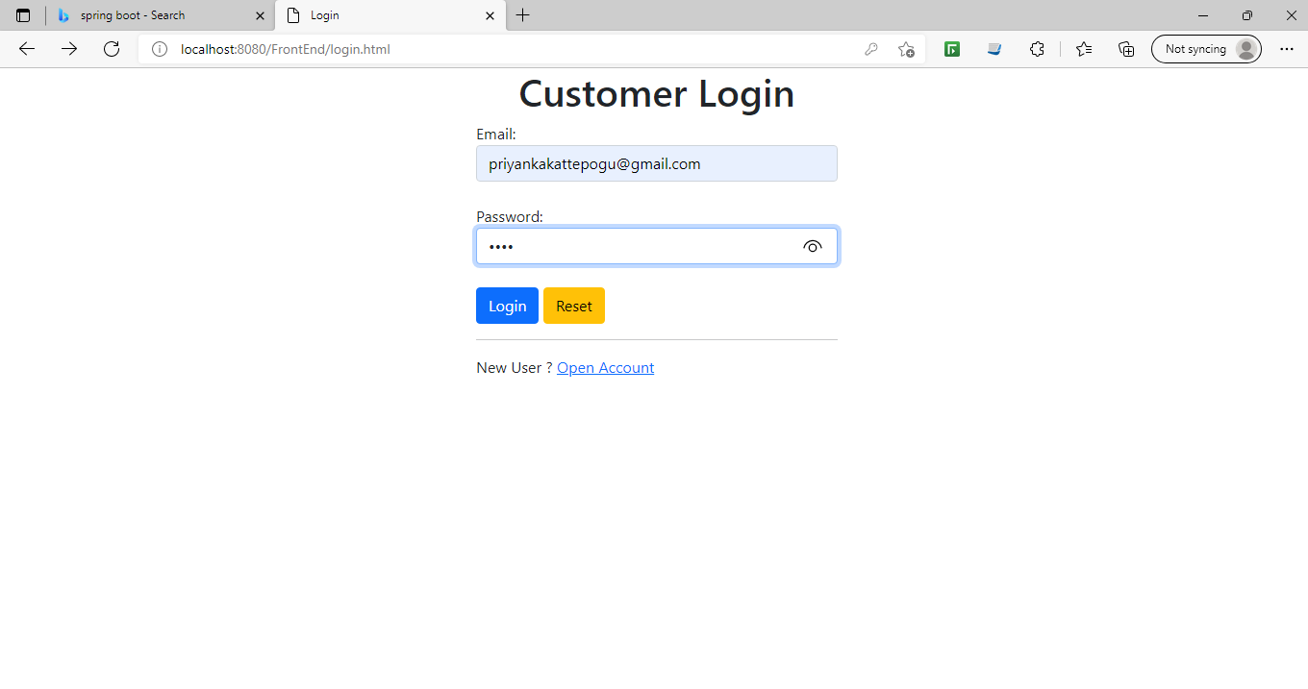
Login Page

Slide 8
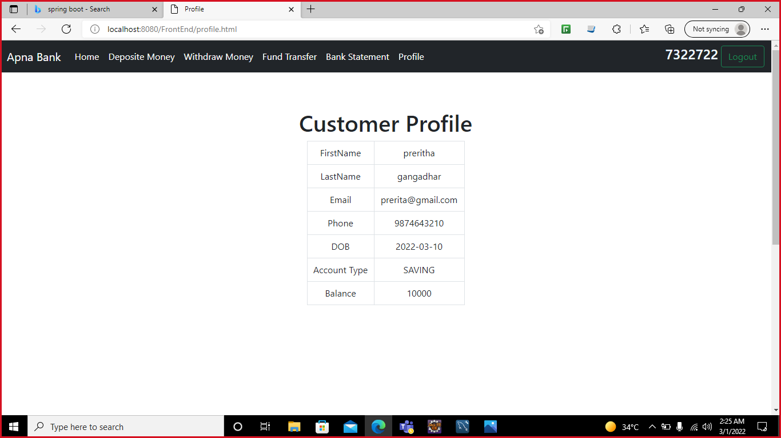
Customer Profile

Slide 9


